Slide 1
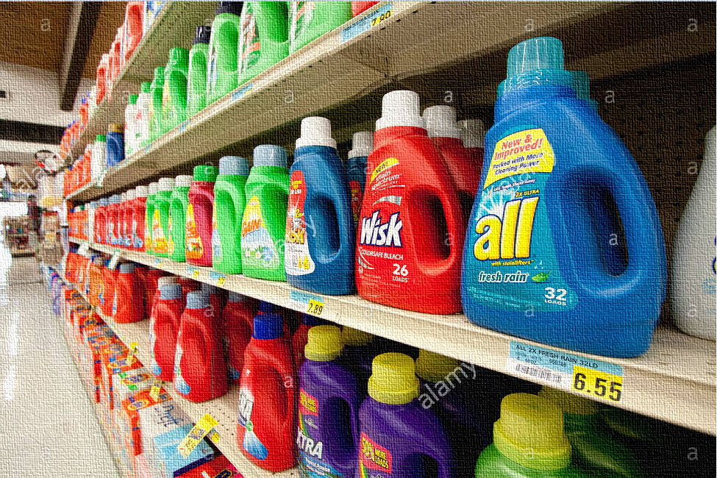
ALL LIQUID
DETERGENT
BRAND MANAGEMENT

Slide 2

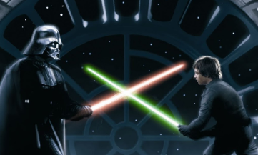


General Overview
Know Your Customer
Know Your Enemy
How Long Customer Stays?
What Stores to Increase Prices?
Overall Learning
Thank You
Market Share
Why did we choose ALL and liquid detergents?
It is the second largest brand and has opportunity to gain market share
Tide has a monopoly on powder detergents
7.63%
Revenue (Mn)
$13.40
Average Unit Price
$5.21

Slide 3
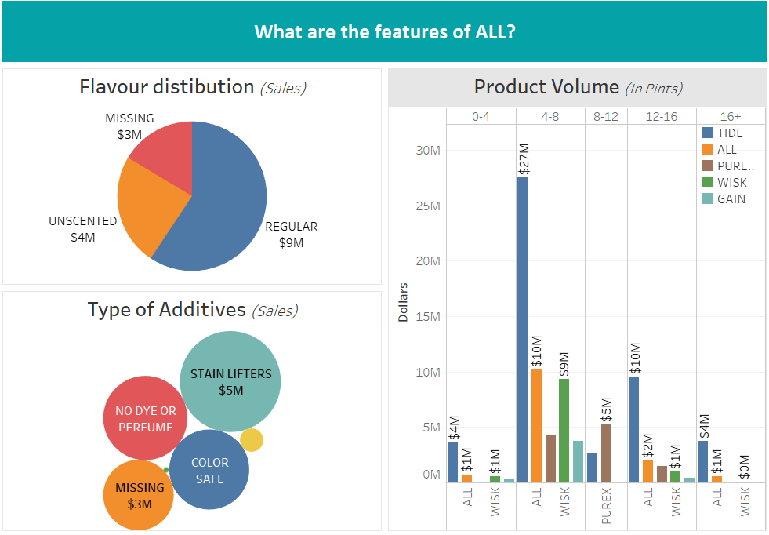
General Overview
Know Your Customer
Know Your Enemy
How Long Customer Stays?
What Stores to Increase Prices?
Overall Learning
Thank You

Slide 4
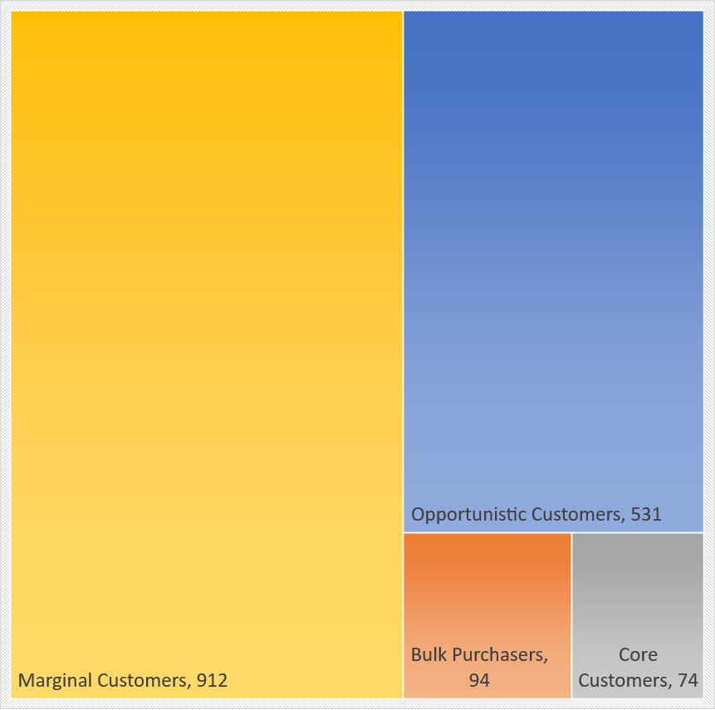
General Overview
Know Your Customer
Know Your Enemy
How Long Customer Stays?
What Stores to Increase Prices?
Overall Learning
Thank You
What type of people buy
All Liquid
Detergent?

Slide 5

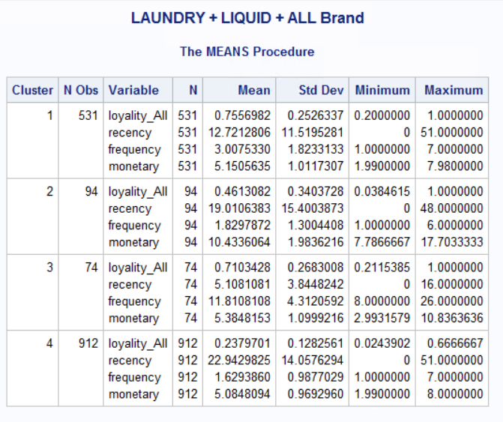
General Overview
Know Your Customer
Know Your Enemy
How Long Customer Stays?
What Stores to Increase Prices?
Overall Learning
Thank You
Cluster 1: Opportunistic Customers These customers wait for promotions and discounts to buy product. Less Recent and frequent in nature.
Cluster 2: Bulk Purchasers These customers buy in bulk with low frequency. Average Transaction value is high for them.
Cluster 3: Core Customers These are loyal customers for the product. Highly loyal, more recent and more frequent in nature.
Cluster 4: Marginal Customers These are not loyal customers and doesn’t show any inclination towards the product.

Slide 6
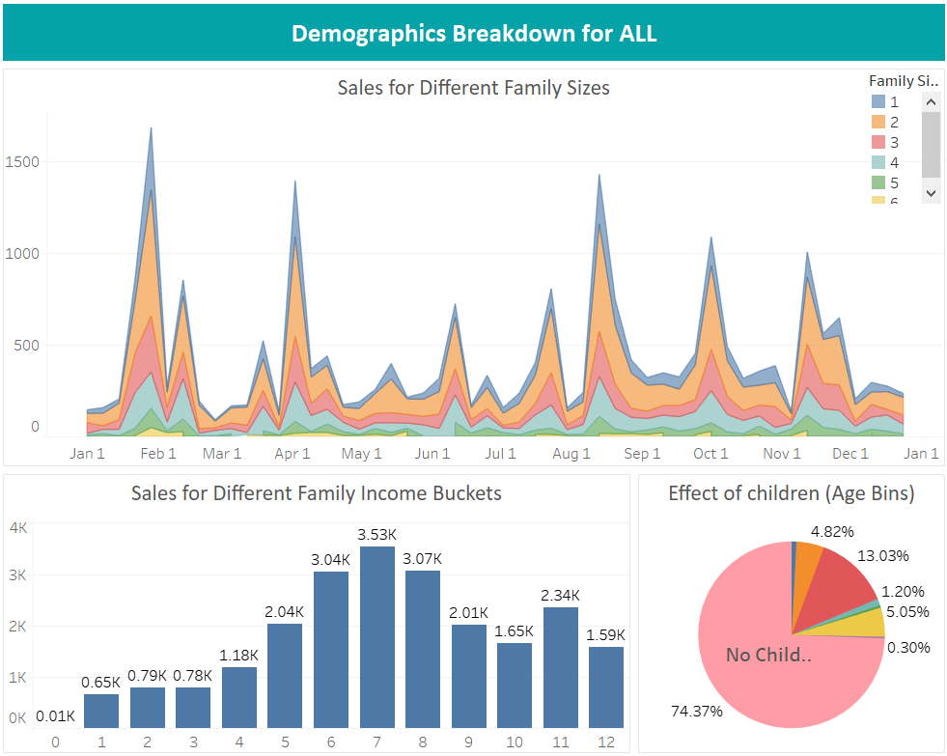
General Overview
Know Your Customer
Know Your Enemy
How Long Customer Stays?
What Stores to Increase Prices?
Overall Learning
Thank You
By improving the room reservation option site flow , there is a potential increase in conversion by 58%

Slide 7
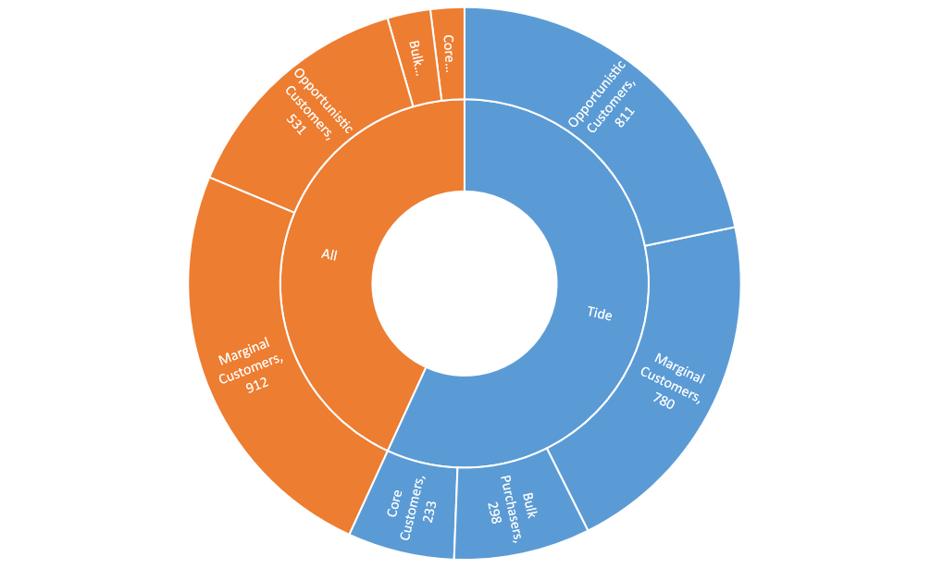
General Overview
Know Your Customer
Know Your Enemy
How Long Customer Stays?
What Stores to Increase Prices?
Overall Learning
Thank You
What type of people buy
Tide vs All Liquid
Detergent?

Slide 8

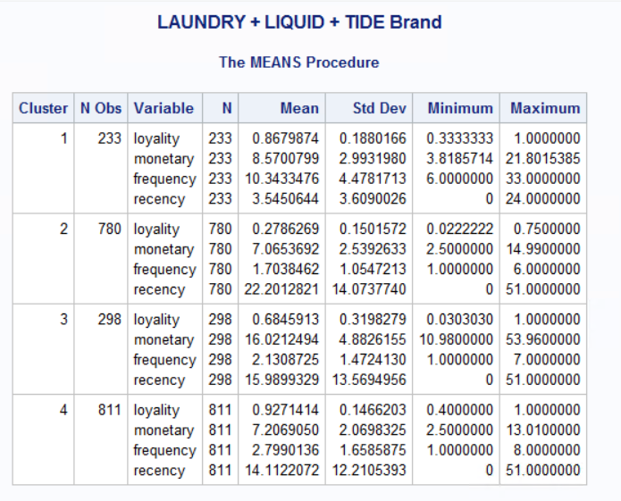
General Overview
Know Your Customer
Know Your Enemy
How Long Customer Stays?
What Stores to Increase Prices?
Overall Learning
Thank You
Opportunist
Customers
Core Customers
Bulk
Customers
Marginal Customers
Core Customers
Bulk Customers
Marginal Customers
Opportunist
Customers

Slide 9
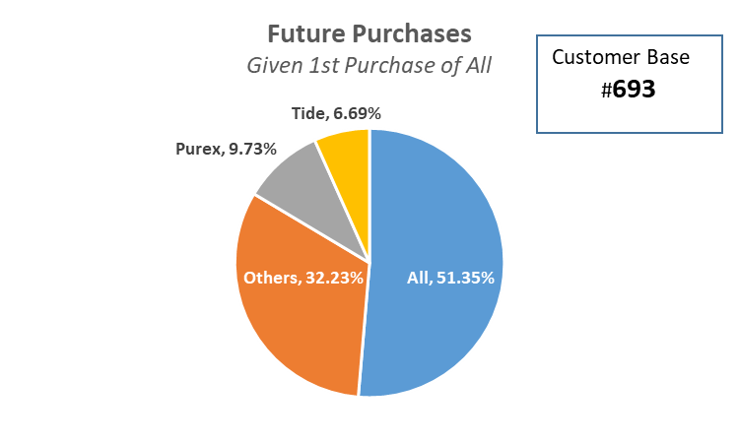
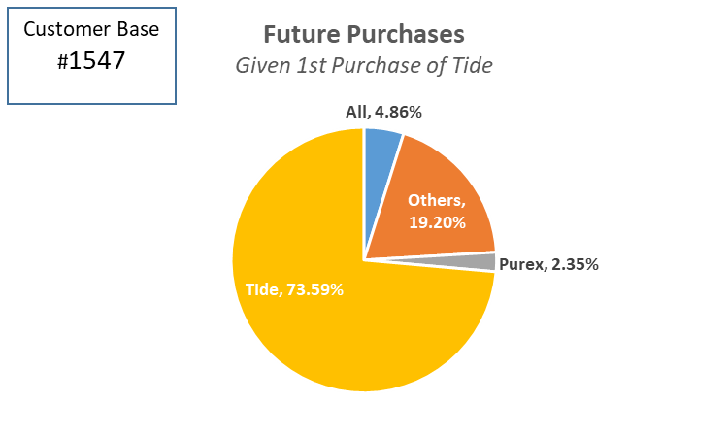
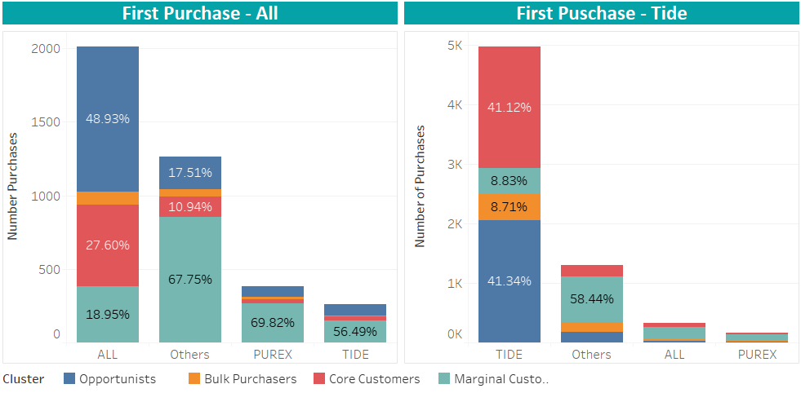
General Overview
Know Your Customer
Know Your Enemy
How Long Customer Stays?
What Stores to Increase Prices?
Overall Learning
Thank You

Slide 10
General Overview
Know Your Customer
Know Your Enemy
How Long Customer Stays?
What Stores to Increase Prices?
Overall Learning
Thank You
ALL Customers
There is a unanimous increment in inter-arrival time for an increase in dollar value
There is a unanimous decrement in inter-arrival time for an increase in family size
For loyal customers of Tide, there is a significant increment in inter-arrival time for people who owns the house as compared to marginals
# of Cats and Dogs represents small family. There is an inclination for small family to buy All over Tide
TIDE Customers
There is a unanimous increment in inter-arrival time for an increase in units bought
Bulk Customer inter-arrival time increases 29% for married as otherwise
Note : Bold represents significant and otherwise not significant.

Slide 11
General Overview
Know Your Customer
Know Your Enemy
How Long Customer Stays?
What Stores to Increase Prices?
Overall Learning
Thank You
Evaluate your Customers
Segment customers based on RFML and understand business value
Demographic Perspective
Identify segments and Target customers based on demographics
Market Strategy
Target audience and their time to come again to promote & advertise
Evaluate your enemy
Segment enemy’s customers based on RFML and understand business value
Calculate Inter-arrival Rate
Apply survival analysis to identify arrival rate for each segments
*eCUST - Enterprise Customer Web Application

Slide 12
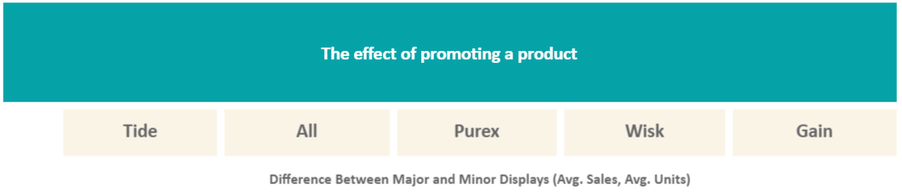
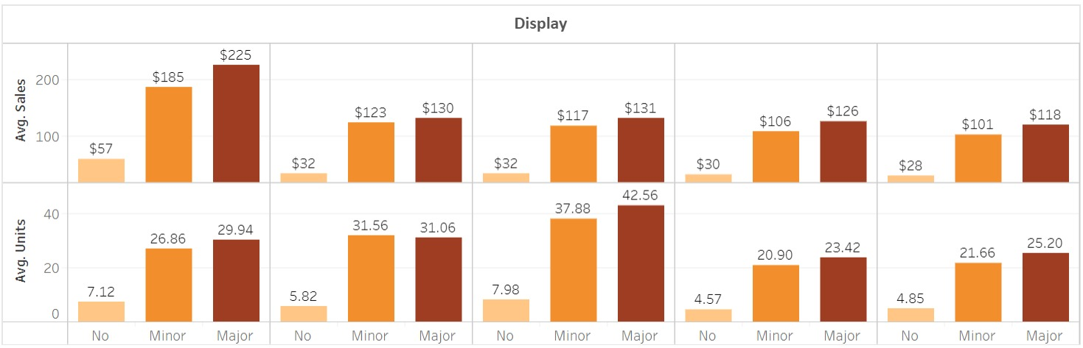
General Overview
Know Your Customer
Know Your Enemy
How Long Customer Stays?
What Stores to Increase Prices?
Overall Learning
Thank You

Slide 13
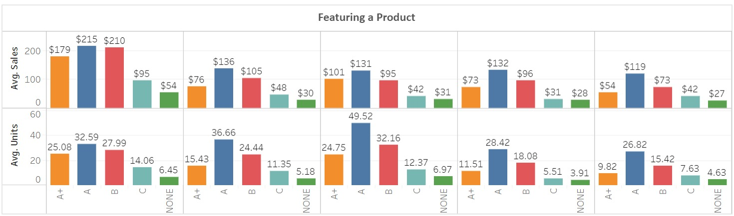
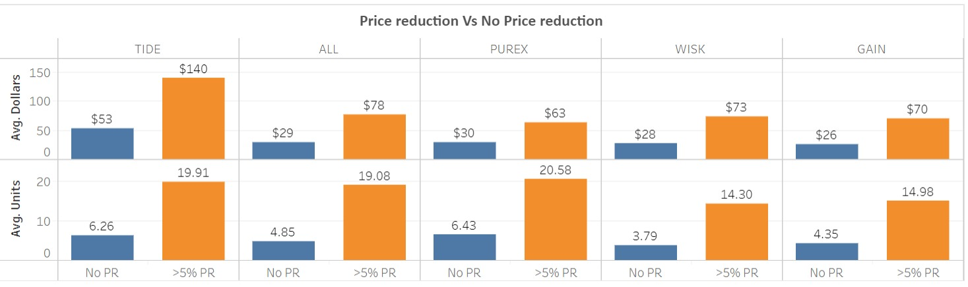
General Overview
Know Your Customer
Know Your Enemy
How Long Customer Stays?
What Stores to Increase Prices?
Overall Learning
Thank You

Slide 14
General Overview
Know Your Customer
Know Your Enemy
How Long Customer Stays?
What Stores to Increase Prices?
Overall Learning
Thank You
Price Elasticity
The measure to know the responsiveness of the sales of a brand to a change in its price / competitor’s price
η = (δSales/ δPrice) * (Average Price / Average Sales)
η(x,y) = (δSales(x)/ δPrice(y)) * (Average Price(y) / Average Sales(x))
Self Price Elasticity
Cross Price Elasticity

Slide 15
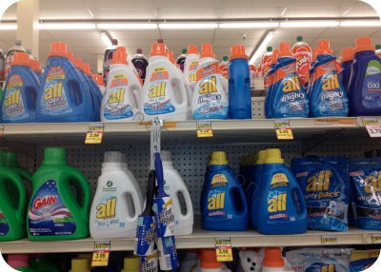
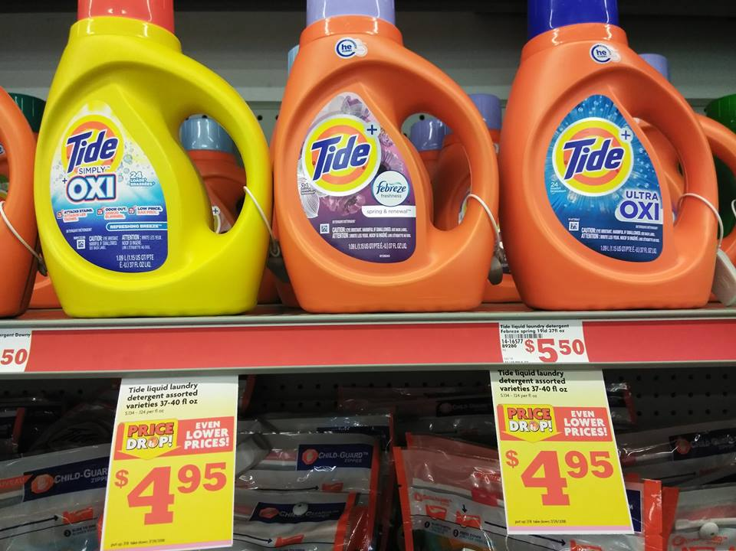
General Overview
Know Your Customer
Know Your Enemy
How Long Customer Stays?
What Stores to Increase Prices?
Overall Learning
Thank You
Price Elasticity
Self Price Elasticity
Cross Price Elasticity
Impact of Own Display Ads, Feature Ads & Price Reduction on Own Sales at store level
Impact of Display Ads, Feature Ads & Price Reduction of Competitor brand on Own Sales at store level

Slide 16
General Overview
Know Your Customer
Know Your Enemy
How Long Customer Stays?
What Stores to Increase Prices?
Overall Learning
Thank You
Self Price Elasticity
Cross Price Elasticity (TIDE)
All stores
(Sales in all 52 weeks)
Display & Feature + Price 1%
Display & Feature + Price 1%
Sales 0.071%
Sales 4.29%
Top 20% stores
Display & Feature + Price 1%
Display & Feature + Price 1%
Sales 3.81%
Sales 0.15%
Bottom 20% stores
Display & Feature + Price 1%
Display & Feature + Price 1%
Sales 0.14%
Sales 2.25%

Slide 17
General Overview
Know Your Customer
Know Your Enemy
How Long Customer Stays?
What Stores to Increase Prices?
Overall Learning
Thank You
Business
Customer Segment on the basis of buying behavior
Identify Loyal, switchers and not-loyal customers for All and Tide
Business
Identify inter-arrival time to identify when the customer is suppose to come next
Business
Identify the impact of Price Reduction, Display & Feature Ads on Sales (Own & Competitor)
Customer Segmentation
Survival Analysis
Price Elasticity
Technical
Calculate Recency, Frequency, Monetary and Loyalty for each household and cluster them accordingly.
Add demographic variable to target customers
Technical
Based on the segments calculated before, run Lifereg model with Weibull distribution
Calculate the impact of demographic variable on inter-arrival time
Technical
Aggregate sales on store and created a balanced panel data with week ids
Performed Fixed effects panel regression model.

Slide 18
General Overview
Know Your Customer
Know Your Enemy
How Long Customer Stays?
What Stores to Increase Prices?
Overall Learning
Thank You
Thank you!

